Slide 1
Module 8
Describing Works
RDA Training
University of Nevada, Las Vegas
May 2013

Slide 2
FRBR Primary Entities
Work
  Expression
    Manifestation
      Item
Notes:
This module will speak about creating records and access points for Works. A later module will speak about making records for manifestations and items. Although they will be needed for some records, RDA has not yet formulated a way to create access points for manifestations and items.

Slide 3
RDA vs. AACR2
AACR2 uniform title definition: “The particular title by which a work is to be identified for cataloguing purposes.”
Not, however, in fact an identifier for a work.
AACR2 uniform title combines aspects of work, expression, and sometimes even manifestation.
Notes:
Although they are somewhat equivalent, AACR2 uniform titles are not the same as RDA access points for works and expressions. Since AACR2 was formulated before the theoretical work of FRBR, its authors were not thinking of the distinction between work, expression, manifestation and item, and so the AACR2 uniform title potentially contains aspects of all these elements. Although it serves the function of gathering or collocation well, the AACR2 uniform title is therefore much less precise than what is looked for in an entity-relationship database such as that envisioned by FRBR and RDA.

Slide 4
RDA vs. AACR2
AACR2 uniform title:
Homer. Odyssey
  Represents the work Odyssey as well as all Greek expressions of the Odyssey, of which there are many.

Slide 5
RDA vs. AACR2
RDA authorized access point for the work:
Homer. Odyssey
  Represents the work Odyssey only, not the Greek expressions
RDA authorized access point for a Greek expression:
Homer. Odyssey. Greek (Monro and Allen)
  Represents the Greek expression of the Odyssey edited by David Monro and Thomas Allen
Notes:
Note with RDA it is clear exactly which FRBR entity is represented by the access point. This should help our users in may cases get to what they need more quickly. We’ll talk about expressions in the next module.

Slide 6
RDA vs. AACR2
AACR2 uniform title:
Homer. Odyssey. Spanish
  Represents all Spanish expressions (translations) of the Odyssey. There are many.

Slide 7
RDA vs. AACR2
RDA authorized access point for one of many Spanish expressions:
Homer. Odyssey. Spanish (Alberich)
  Represents the Spanish translation of the Odyssey by Joan Alberich. There are dozens of other Spanish translations.

Slide 8
RDA vs. AACR2
Why is it important to be this precise?
  Because RDA is working toward an entity-relationship structure, and in this structure each work and each expression will have a separate description. If the database uses access points, each description will need to have a distinct access point.
  Even in the absence of an ER database, this precision will be helpful to our users.
Notes:
I had to fish around a long time in our catalog to find the exact expressions I wanted because the AACR2 uniform titles were so imprecise. And we do use uniform titles in our catalog. As a user my searching would have been much quicker had we used precise RDA access points throughout.

Slide 9


FRBR Relationships (Groups 1-2)
Work: Piedra de sol
created by
Person: Octavio Paz
realized through
Expression: English
has a translation
Expression: Spanish
translated by
Person: Muriel Rukeyser
Notes:
A reminder of how this might work in an ER database. Each entity clearly has a separate description (the blue boxes).
In this diagram we see various relationships between entities. Octavio Paz has a creator relationship with Piedra de sol. The work has a “realized through” relationship with the two expressions; and notice the expression entities also have a relationship to each other. Finally, the English expression has a “translated by” relationship with another person entity, Muriel Rukeyser.

Slide 10
Please log in to RDA
Please feel free to sign up later for a month’s free access so you can practice (see handout)
Notes:
From now on, as I show slides of RDA, please feel free to go ahead and look yourself in the Toolkit.

Slide 11
Identifying Works: MARC Coding
Works are currently described in the MARC authority format.
RDA records identified by “z” in 008/10 (“Rules”) and $e rda in 040

Slide 12
Identifying Works: Definition
5.1.2. The term work refers to a distinct intellectual or artistic creation (i.e., the intellectual or artistic content).
The terms work and expression should be read, where applicable, to include not only an individual entity, but also aggregates and components of such entities (i.e., the term work should be read to include aggregate works and components of works as well as individual works, etc).
Notes:
Think of some examples of works.

Slide 13
Identifying Works: Core Elements
Preferred title for the work
Identifier for the work
Musical works with non-distinctive titles
  Medium of performance
  Numeric designation
  Key
Bilateral treaties
  Signatory
Notes:
Open to 5.3, looking for the core elements for works (click through as they find them)
Note again that core elements are required, but do not necessarily wind up in the authorized access point for the work.

Slide 14
Identifying Works:
Core if needed to distinguish
Form of work
Date of work
Place of origin of the work
Other distinguishing characteristic of the work
Musical works with distinctive titles
  Medium of performance
  Numeric designation
  Key

Slide 15
Identifying Works: Core Elements
The author / creator is not a core element of the work entity.
Authors can be persons, families, or corporate bodies, and they are separate entities, related to the work entity--an author has a relationship with a work
However, the access point will contain the name of the author, if there is one. This is a link, not an element of the work entity.

Slide 16
Identifying Works
Transcription and Capitalization
Follow 1.7. General guidelines on transcription (not the alternatives)
6.2.1.4. Capitalization. Follow Appendix A.3 and A.4.
6.2.1.6. Diacritical marks: record them as they appear; add them if it is certain that they are integral to the title but were omitted in the source
6.2.1.7. Omit initial articles (NACO follows the alternative)
6.2.1.9. Abbreviations. Record only abbreviations that are found in the source.
5.4. Language and script. NACO policy = Romanize vernacular scripts.

Slide 17
Transcription example
Forms found for title:
Piedra de Sol
PIEDRA DE SOL
Manipulation of capitalization according to Appendix A:
Piedra de sol
Notes:
Refer to A.1; A.3; A.4; A.52.

Slide 18
RDA 5.8. Source Consulted
Record in 670 field, or 3XX $u/$v
Always include one 670 for the work being cataloged
Others included if needed to justify information in the description
Suggested format:
  670 $a Title proper, date: $b citation (data)
Notes:
Everyone go to RDA 5.8

Slide 19
670 field examples
  670 $a The tragedy of Romeo and Juliet, 1982
670 $a Russian Wikipedia, June 19, 2012 $b (Анна Каренина = Anna Karenina; written 1873-1877, first publication 1875-1877)
670 $a Rin itsu shō, 2012: $b t.p. (源氏物語古注集成 = Genji monogatari kochū shūsei)
670 $a Homeri Odyssea, 1909-
670 $a Dr. Seuss's Green eggs and ham, 1995
Notes:
Explain the OCLC 670.
There are lots of ways to form these. The point is, record information justifying what you’ve included in other elements in the description.
Note: when getting information about titles for works it is often only necessary to record $a.

Slide 20
Identifying Works
Sources of Information
Where can we get information about works?
  6.1.1: Take the title or titles of the work from any source. Take information on other identifying attributes of works and expressions from any source.
Notes:
Now please turn to Chapter 6 if you’re not already there.

Slide 21
Identifying Works: Sources
Sources to check
  The resource you are cataloging
  The LC/NACO Authority File (authorities.loc.gov)
  Your database (e.g. OCLC)
  Optional: Other useful sources
    Virtual International Authority File (http://viaf.org)
    Wikipedia (http://www.wikipedia.org/)
    Other sources such as encyclopedias and dictionaries

Slide 22
Attributes of Works: Title
Preferred title is a core element
Preferred title (modern works)
  Chosen according to 6.2.2.4: “For works created after 1500, choose as the preferred title the title in the original language by which the work has become known through use in resources embodying the work or in reference sources.”
Notes:
Please go to 6.2. This is the familiar “commonly known form” principle.

Slide 23
Attributes of Works: Title
We find two possible titles for this work. Which would we choose as the preferred title?
Notes:
Refer to 6.2.2.4.

Slide 24
Attributes of Works: Title
Preferred title (works created before 1501)
  Chosen according to 6.2.2.5: “For works created before 1501, choose the title or form of title in the original language by which the work is identified in modern reference sources as the preferred title.”
  Note special rules for Greek and anonymous works

Slide 25
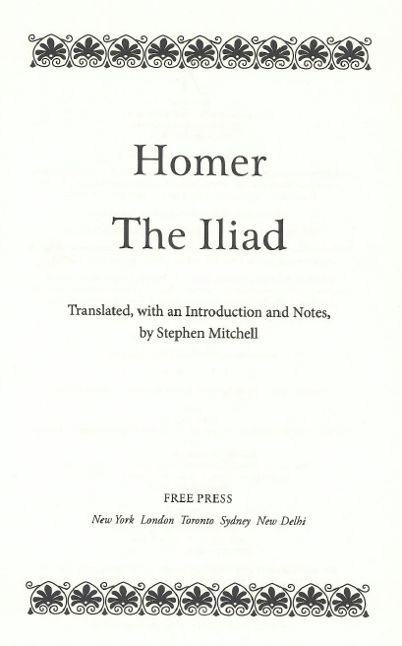
Preferred title?
Modern translation,
published 2011
Notes:
A pre-1501 work--we’re supposed to go to reference works.

Slide 26
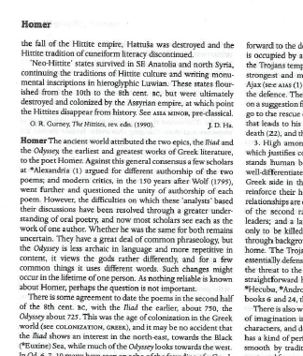
Preferred title?
Modern reference
source: Oxford
classical dictionary,
1996, p. 718
Notes:
A pre-1500 work--we’re supposed to go to reference works.

Slide 27
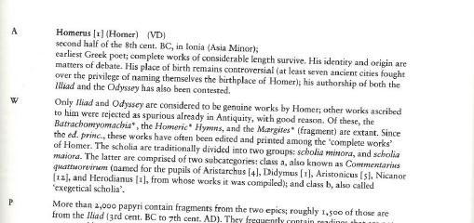
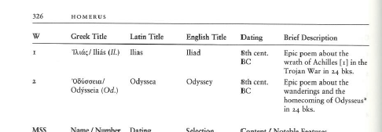
Preferred title?
Brill’s new Pauly dictionary of Greek and Latin authors and texts, 2009, p. 325-326
Iliad (English)?
Ilias (Latin)?
Ἰλιάς (Greek)?
Notes:
A pre-1501 work--we’re supposed to go to reference works. This reference work refers in the main body of the article as Iliad.

Slide 28
Attributes of Works: Preferred Title
Parts of works (6.2.2.9)
  One part - choose preferred title as already shown
    Two towers
    King of the hill
    Can be generic (append to the preferred title of the work)
    Episode 2, e.g.
      Downton Abbey. Season 1, Episode 2
    Introduction
      This side of paradise. Preface

Slide 29
Attributes of Works: Preferred Title
Parts of works (6.2.2.9)
  More than one part
    Numbered consecutive parts: give the general term in the singular with the number (append to the preferred title of the work)
      Book 1-5, e.g.
        Commentary on the Epistle to the Romans. Book 1-5
    Unnumbered or nonconsecutive parts: either
      Record each part separately (i.e. treat each as a single part)
      Append “Selections” to the preferred title of the work as a whole, e.g., for a compilation called “Soliloquies from Hamlet”
        Hamlet. Selections
Notes:
REMEMBER none of these is the complete authorized access point. We shall see that the AAP begins with the AAP for the creator, which is a link to the description of that person/family/cb. We’re JUST recording the title attribute here.

Slide 30
Attributes of Works: Preferred Title
Compilations of works (6.2.2.10)
  Either
  Record each work separately
  and/or
  Use a conventional collective title

Slide 31
Attributes of Works: Preferred Title
Compilations of works (6.2.2.10): conventional collective title
  Compilation purports to be the complete works of an author, use Works
  Compilation purports to be the complete works of an author in a single form, use one of the following:
    Correspondence
    Essays
    Novels
    Plays
    Poems
    Prose works
    Short stories
    Speeches
    Or another appropriate specific collective title such as “Fragments” “Architectural drawings” etc.

Slide 32
Attributes of Works: Preferred Title
Compilations of works (6.2.2.10): conventional collective title
  Compilation is less than the complete works of the author
    Either record each work separately
    and/or append the term “Selections” to the appropriate conventional collective title, e.g.
      Works. Selections
      Plays. Selections
      Speeches. Selections
  NOTE: “Selections” can no longer stand alone.

Slide 33
Attributes of Works: Preferred Title (MARC)
Most RDA entity attributes have a discrete place in MARC to record them. Preferred title does not. It can only be recorded as part of the authorized access point for the work.
Record in the MARC authorities format 1XX field, indicators as appropriate to the field
Record the preferred title in subfield $t (100, 110, 111) or subfield $a (130). Other subfields may be appropriate
Notes:
LOOK AT MARC authority format 100, 110, 111, 130 field.

Slide 34
Attributes of Works: Preferred Title (MARC examples)
The preferred title is bolded in each example
    100 1 $a Carter, Jimmy, $d 1924- $t Living faith
    100 1 $a Smith, Joseph, $c Jr., $d 1805-1844. $t King Follett discourse
    100 0 $a Elizabeth $b I, $c Queen of England, $d 1533-1603. $t Correspondence
    100 1 $a Mozart, Wolfgang Amadeus, $d 1756-1791. $t Works. $k Selections
    110 2 $a Banco de Bilbao. $t Informe y memoria
    110 1 $a United States. $b Department of Defense. $t Military commission order
    130 0 $a Beowulf
    130 0 $a Primary colors
    130 0 $a Planet of the apes (Motion picture : 1968)
Notes:
The preferred title element is bolded. Parts preceding the preferred title are not part of the RDA work description.
Take two authority worksheets. Record the preferred title for the Homer and the Octavio Paz work in subfield $t of the 100 field. Leave space to the left, we’ll be putting something there.

Slide 35
Attributes of Works: Variant Title
Variant title (6.2.3)
Any version of the title that differs from the form chosen as the preferred title.

Slide 36
Attributes of Works:
Variant Title (MARC)
Like the Preferred Title element, the Variant Title element (RDA 6.2.3) does not have a discrete place in MARC. It can only be recorded as part of the variant access point for the work.
Record in the MARC authorities format 4XX field, indicators as appropriate to the field
Record the variant title in subfield $t (400, 410, 411) or subfield $a (430). Other subfields may be appropriate
Notes:
LOOK AT MARC authority format 400 field.

Slide 37
Attributes of Works:
Variant Title (MARC examples)
The variant title is bolded in each example
    400 1 $a Carter, Jimmy, $d 1924- $t Personal beliefs of Jimmy Carter
    400 1 $a Mozart, Wolfgang Amadeus, $d 1756-1791. $t Best of Mozart
    410 2 $a Banco de Bilbao. $t Annual report and accounts
    410 1 $a United States. $b Department of Defense. $t Department of Defense military commission order
    430 0 $a Bjowulf
    430 0 $a Primary colors
    430 0 $a Monkey planet (Motion picture)
Notes:
The variant title element is bolded. Parts preceding the preferred title are not part of the RDA work description.
Take two authority worksheets. Record the any variant titles for the Homer and the Octavio Paz work in subfield $t of the 400 field. Leave space to the left, we’ll be putting something there.

Slide 38
Attributes of Works: Form
RDA 6.3. Form of work is core if needed to differentiate the name of a work from the name of another entity (another work, or the name of a person, family, or corporate body)
It can be recorded as an element whether or not needed to distinguish
Record in MARC 380 field
There is no controlled vocabulary

Slide 39
Work Authority Record
Piedra de sol, Iliad
The form of both works is “Poem”.
380 $a Poem
Exercise: Add this to the authority records.
Notes:
Or use controlled vocabulary.

Slide 40
Attributes of Works: Date
RDA 6.4. Date is defined as the earliest date associated with a work. Lacking other evidence, the date of the first publication may be used
Date is core only if needed to differentiate between a work and other entities with the same name.
The element may be recorded whether needed to distinguish or not.
Date is recorded in MARC 046
  Beginning date or single date = $k
  Ending date = $l

Slide 41
Work Authority Record
Piedra de sol
This work was first published in 1957. The cataloger has no other information about the date of the work.
046 $k 1957
Exercise: add this field to the appropriate RDA authority record.

Slide 42
Work Authority Record
Iliad
According to Brill’s New Pauly this work was created in the second half of the 8th century BC.
046 $k -07
Exercise: add this field to the appropriate RDA authority record.
Notes:
Explain about BC dates.

Slide 43
Attributes of Works: Place of Origin
RDA 6.5. Place of origin of the work is the country or other territorial jurisdiction from which a work originated.
It is not the setting of the work (what the work is “about”)
Information may be taken from any source.
Place of origin is core if needed to differentiate.
Whether core or not, the element may be recorded.
Place of origin is recorded in MARC 370 field $g

Slide 44
Recording the Place Attribute
The form of the place name is governed by RDA Chapter 16.
Authorized access points for jurisdictional place names are generally formed as in AACR2, e.g. “Paris (France)” However:
16.2.2.4. “If the place name is being used to record ... the place of origin of a work ... precede the name of the larger place by a comma.” -- e.g. “Paris, France”
Notes:
Important Reminder from the earlier session

Slide 45
Recording the Place Attribute
6.5.1.3 instructs us to follow chapter 16, including abbreviations; chapter 16 refers us to Appendix B.
B.11 is similar to the place names abbreviations list in AACR2
So when recording this attribute for a person, use, e.g., “U.S.”, not “United States.”
Notes:
LOOK at B.11

Slide 46
Work Authority Record
Piedra de sol
  The cataloger only knows that the place of origin of Piedra de sol is Mexico.
  This place is established as Mexico
    370 $g Mexico
Exercise: Record place of origin in the authority record

Slide 47
Work Authority Record
Iliad
  According to Brill’s New Pauly, this work was created in Ionia (Asia Minor).
  This place is established as Ionia; Asia Minor is established as Turkey
    370 $g Ionia $g Turkey
Exercise: Record place of origin in the authority record

Slide 48
Attributes of Works: Place of Origin
046 $k 1495˜ $l 1497 $2 edtf
100 0 $a Leonardo, $c da Vinci, $d 1452-1519. $t Last supper
370 $g Milan, Italy
373 $a Santa Maria delle Grazie (Church : Milan, Italy)
380 $a Mural
Notes:
Place of origin might not be recorded for a work such as a novel that isn’t strongly associated with a particular place of origin, but here’s an example of a work that is strongly associated with a place of origin. This work was created in Milan and it’s still there.

Slide 49
Attributes of Works: Other Distinguishing Characteristics
6.6. A characteristic that serves to differentiate the name of a work from another entity with the same name
Core if needed to differentiate
May be recorded, whether needed to distinguish or not
  Various MARC fields
    046 (date)
    370 (place)
    373 (corporate body)
    380 (form)
    381 (anything else)

Slide 50
Attributes of Works: Other Distinguishing Characteristics
046 $k 1965
130 0 $a Harlow (Motion picture : 1965 : Segal)
380 $a Motion picture
381 $a Segal
500 1 $w r $i Film director: $a Segal, Alex, $d 1915-1977

Slide 51
Attributes of Works:
Other RDA Elements
6.7. History of the Work. Recorded in MARC 678
6.8. Identifier. Core element; LCCN, recorded in 010
Musical works: RDA 6.14-6.18
Legal works: RDA 6.19-6.22
Religious works: RDA 6.26
Notes:
Just drawing your attention to these elements, no time to go through, EXCEPT two: a brief whirl through preferred titles for musical works because we’ll be learing about cataloging scores and recordings; and one important change: Bible access points.

Slide 52
A Brief Whirl Through
Musical Works
Most of the attributes of other works also apply to musical works, but
  Titles (some differences)
  Attributes applicable only to musical works
    Medium of performance
    Numeric designation
    Key
Notes:
We’re just going to quickly go through these so you’ll have some exposure to descriptions of musical works and understand what is going on, not so that you can start creating descriptions.

Slide 53
Attributes of Musical Works:
Preferred Title
6.14.2.3. “Choose as the preferred title for a musical work the composer’s original title in the language in which it was presented.”
    Die Zauberflöte
    Missa luba
    Lip my reeds
Basically the same as for other works. BUT ...

Slide 54
Attributes of Musical Works:
Preferred Title manipulation
Titles of musical works are manipulated before recording
6.14.2.4. Remove:
  medium of performance
  key
  any numbers unless integral to the title
  date of composition
  NACO catalogers also remove initial articles (6.2.1.7 alternative)

Slide 55
Attributes of Musical Works:
Preferred Title manipulation
Sonata in G major for two double basses becomes
  Sonata [remove key, medium of performance]
Trio for flute, viola, and piano, 1948 becomes
  Trio [remove medium of performance, date of composition]
Sofien-Tänze für das Piano-Forte, 185tes Werk becomes
  Sofien-Tänze [remove medium of performance, opus number]
    Die Zauberflöte becomes
      Zauberflöte [remove initial article]

Slide 56
Attributes of Musical Works:
Preferred Title manipulation
If the result of 6.14.2.5 is solely the name of one type of composition, record it in English, if there’s an English form, and record in the plural unless the composer wrote only one work of the type.
  Sonata in G major for two double basses becomes
    Sonata [remove key, medium of performance] becomes
      Sonatas
  Trio for flute, viola, and piano, 1948 becomes
    Trio [remove medium of performance, date of composition] becomes
      Trios
  Sofien-Tänze für das Piano-Forte, 185tes Werk becomes
    Sofien-Tänze [remove medium of performance, opus number] remains
      Sofien-Tänze
      Die Zauberflöte becomes
        Zauberflöte [remove initial article] remains
          Zauberflöte

Slide 57
Attributes of Musical Works:
Preferred Title manipulation
Stay tuned! We’ll add some of these things back in when we create the authorized access point.

Slide 58
Attributes of Musical Works:
Medium of Performance
6.15. Medium of performance is is the instrument, instruments, voice, voices, etc., for which a musical work was originally conceived.
Record according to the instructions in 6.15.1.3.
Record in MARC authority 382 field, subfield $a

Slide 59
Attributes of Musical Works:
Medium of Performance
382 $a orchestra
382 $a mixed voices $a orchestra
382 $a organ
382 $a countertenor $a keyboard
382 $a bassoon $a tuba
382 $a mezzo-soprano $a piano
382 $a flute $a oboe $a bassoon $a trombone $a violin $a contrabass

Slide 60
Attributes of Musical Works:
Numeric Designation
6.16. Serial number, opus number, or thematic index number
Record in MARC authorities 383 field
  $a Serial number
  $b Opus number
  $c Thematic index number
  $d Thematic index code
  $e Publisher associated with opus number
$d codes: http://bcc.musiclibraryassoc.org/BCC-Historical/BCC2011/Thematic_Indexes.htm

Slide 61
Attributes of Musical Works:
Numeric Designation
Serial number
383 $a no. 26
Opus number
383 $b op. 15
Serial and opus number
383 $a no. 4 $b op. 53
Thematic index number
383 $c K. 537 $d Köchel6 $2 mlati
383 $c BWV 211 $d Wohlfarth $2 mlati

Slide 62
Attributes of Musical Works:
Key (6.17)
Key is determined by the adherence of a musical work (or a part of a musical work) to the note pattern of a major or minor scale.
If the key can be determined, record it in a MARC authority 384 field, first indicator “0”, subfield $a.

Slide 63
Attributes of Musical Works:
Key (6.17)
384 0 $a B♭ major
384 0 $a D minor
384 0 $a F major
384 0 $a A minor
384 0 $a C♯ major

Slide 64
Preferred Title of a Religious Work
Sacred Scripture (Parts of the Bible)
O.T. and N.T. are no longer abbreviated. “Old Testament” and “New Testament” will be used.
Individual books are no longer grouped under a testament.
  130 0 $a Bible. $p New Testament
  not
  130 0 $a Bible. $p N.T.
  130 0 $a Bible. $p Leviticus
  not
  130 0 $a Bible. $p O.T. $p Leviticus
Notes:
THIS IS A MAJOR CHANGE
Bible access points are formed the same as AACR2 uniform titles, EXCEPT (see slide)

Slide 65
Bible Preferred Titles
AACR2
Bible. O.T. Genesis
Bible. O.T. Pentateuch
Bible. N.T. Mark
Bible. N.T. Pastoral Epistles
Bible. N.T.
RDA
Bible. Genesis
Bible. Pentateuch
Bible. Mark
Bible. Pastoral Epistles
Bible. New Testament
[used only for the entire New Testament, not individual books]

Slide 66
Constructing the Authorized Access Point for a Work (RDA 6.27.1)
Works created by one person, family, or corporate body (6.27.1.2)
  Record the authorized access point for the person, family, or corporate body (this serves as a link to the record for the creator)
  Record the preferred title of the work
Use MARC 1XX field.
  Authorized access point for creator identical to form in its own record, with identical subfield coding
  Preferred title of work in subfield $t, $n, $p, $k

Slide 67
Constructing the Authorized Access Point for a Work (RDA 6.27.1)
Collaborative works (6.27.1.3)
  Record the authorized access point for the person, family, or corporate body with principal responsibility for the work (this serves as a link to the record for the creator) [NOTE: No “rule of three”]
  Record the preferred title of the work
Use MARC 1XX field.
  Authorized access point for principal creator identical to form in its own record, with identical subfield coding
  Preferred title of work in subfield $t, $n, $p, $k
Notes:
THIS IS A SLIGHT CHANGE FROM AACR2: No rule of three; so the person, family, or corporate body with principal responsibility is usually the first named author, no matter how many there are. This means there will be more works entered under an author’s name than there were in AACR2.

Slide 68
Constructing the Authorized Access Point for a Work (RDA 6.27.1)
Collaborative works (6.27.1.3)
  Corporate bodies can be creators (19.2.1.1.1)
    Works of an administrative nature dealing with the body itself
    Works that record the collective thought of the body
    Works that report the collective activity of a meeting, expedition, or event
    Some works that result from the collective activity of a performing group
    Cartographic works originating with a corporate body
    Certain legal works
    Named works of art by two or more artists acting as a corporate body
Notes:
Read together 19.2.1.1.1

Slide 69
Constructing the Authorized Access Point for a Work (RDA 6.27.1)
Collaborative works (6.27.1.3)
  Moving image works
    The access point is created by recording the preferred title alone (no access point for creator)
  NOTE: this applies to most motion pictures, which are usually collaborative works. If a motion picture is the work of a single person, family, or corporate body, its access point is created according to 6.27.1.2 (authorized access point for creator + preferred title of the work)

Slide 70
Constructing the Authorized Access Point for a Work (RDA 6.27.1)
Compilations of works by different persons, families, or corporate bodies (6.27.1.4)
  The access point is created by recording the preferred title alone (no access point for any creator)
  The preferred title is the collective title for the compilation (an aggregate work)
  If there is no collective title, separate access points are constructed for the individual works in the compilation
Notes:
Contrast compilation with collaborative work

Slide 71
Constructing the Authorized Access Point for a Work (RDA 6.27.1)
Works of uncertain or unknown origin (6.27.1.8)
  The access point is created by recording the preferred title alone (no access point for any creator)
Notes:
Anonymous works

Slide 72
Additions to Authorized Access Points for Works
When to make additions (RDA 6.27.1.9)
  If access point is the same or similar to the access point for a different work
  If access point is the same or similar to the access point that represents a person, family, corporate body, or place
Looking for conflicts (LC/PCC PS)
  Where to look? The “catalog” (e.g. local catalog, LC, OCLC). This is required.
  Any resource the cataloger searches, whether in a catalog or not. This is optional.
  Do not predict conflicts

Slide 73
Access point same or similar to access point for a different work
Loos, Anita, 1893-1981. Gentlemen prefer blondes
Loos, Anita, 1893-1981. Gentlemen prefer blondes (Play)
Gale, Zona, 1874-1938. Miss Lulu Bett (Novel)
Gale, Zona, 1874-1938. Miss Lulu Bett (Play)
Under Capricorn (Motion picture)
Under Capricorn (Series)
Under Capricorn (Television program)
Notes:
Later slides cover the various elements that can be added to differentiate works, with examples, so it’s not necessary to dwell on this slide. However, explanations are provided below. This slide illustrates only one kind of element that can be added: form of work.
The first pair of examples represents a situation where the access point for the novel Gentlemen prefer blondes is already established. When the access point for the play with the same title by the same creator is needed, the newly established access point will be qualified. The already existing access point for the novel can be left unqualified.
In the second pair of examples, both access points are being established at the same time, so both are qualified.

Slide 74
Access point same or similar to access point for a different work
130 0_ History of the United States (Harris, Rothman, and Thernstrom)
245 14 The history of the United States / $c edited by Neil Harris, David J. Rothman, Stephan Thernstrom.
264 _1 New York : $b Holt, Rinehart and Winston, $c 1969.
130 0_ History of the United States (Lefler)
245 12 A history of the United States : $b from the age of exploration to 1865 / $c edited by Hugh T. Lefler.
264 _1 New York : $b Meridian Books, $c 1960.
130 0_ History of the United States (Butterworth)
245 10 History of the United States / $c edited by Hezekiah Butterworth.
264 _1 New York : $b Saalfield, $c 1904.
Notes:
This slide shows a significant change from AACR2 for monograph catalogers. In RDA, works named by title alone will need to be qualified to distinguish them from other works named by title alone. The choice of qualifier is cataloger judgment. In these examples, the editor name has been used, but other choices are possible, such as date of work, place of origin, or other characteristics such as publisher name. An authority record for these is not necessarily required, unless the bibliographic record is being authenticated as a BIBCO record (042 pcc).

Slide 75
Access point same or similar to access point for a different work
130 0_ Plato (Essays : Fine)
245 10 Plato / $c edited by Gail Fine.
264 _1 New York : $b Oxford University Press, $c 1999.
490 1_ Oxford readings in philosophy
130 0_ Plato (Essays : Vlastos)
245 10 Plato : $b a collection of critical essays / $c edited by Gregory Vlastos.
264 _1 Garden City, New York : $b Anchor Books, $c 1971.
Notes:
These examples illustrate that sometimes a single addition is not sufficient to distinguish works with the same title. The two works are collections of essays and the cataloger has decided to use form of work combined with another characteristic of the work, the name of the editor. Editor alone would have created a unique authorized access point, but the cataloger judged that it might not necessarily be the most comprehensible authorized access point.
Note also that these examples fall under the second category of when a qualifier is added to the access point for the work: when the authorized access point would be same as one for a person, family, corporate body, or place (next slide).
The second reason to make an addition to an access point for a work is when the access point needs to be distinguished from one that represents a person, family, corporate body, or place. This is a significant change from AACR2 cataloger, particularly for monographs. It means that many works named by title only when the title is the same as that of an access point for a person, family, corporate body, or place will need to be to have an authorized access point for the title with a qualifier added to bibliographic records. In such cases, an NAR is not necessarily required, unless the bibliographic record is being authenticated as a BIBCO record (042 pcc).

Slide 76
Needed to distinguish access point from one that represents a person, family, corporate body, or place
130 0_ Beach boys (Photographs)
245 10 Beach boys.
264 _1 [Sydney] : $b Blue Books, $c [2004]
650 _0 Photography of men.
650 _0 Photography of the nude.
130 0_ Philippines (Folk songs)
245 10 Philippines : $b musique des hautes-terres palawan.
264 _1 [France] : $b Chant du monde, $c [1987]
300 1 audio disc ; $c 12 in.
Notes:
The second reason to make an addition to an access point for a work is when the access point needs to be distinguished from one that represents a person, family, corporate body, or place. This is a significant change from AACR2 cataloger, particularly for monographs. It means that many works named by title only when the title is the same as that of an access point for a person, family, corporate body, or place will need to be to have an authorized access point for the title with a qualifier added to bibliographic records. In such cases, an NAR is not necessarily required, unless the bibliographic record is being authenticated as a BIBCO record (042 pcc).
In the first example, the title of this work consisting of photographs is identical to the authorized access point for a musical group. In the second example, the title of an audio recording of folk songs is identical to the authorized access point for a place. In both examples, form of work has been added to distinguish the works, but other choices could have been made instead (date of work, place of origin, or other distinguishing characteristic such as publisher.

Slide 77
Needed to distinguish access point from one that represents a person, family, corporate body, or place
130 0_ American Museum of Natural History (Photograph)
245 10 American Museum of Natural History.
264 _0 $c [1892?]
300 1 photograph : $b black and white ; $c 56 x 78 cm
500 Photographer unknown.
130 0_ American Museum of Natural History (Model)
245 10 American Museum of Natural History.
264 _3 [Canada] : $b Charles Products, $c [between 1950 and 2011?]
300 1 model ; $c 3 x 10 x 3 cm
340 pewter

Slide 78
Additions to Authorized Access Points for Works
Other considerations (LC/PCC PS)
  Resolve conflicts by adding qualifier to the new authorized access point, not the old one (with some exceptions)
  Use an authorized access point to represent a resource when it is referred to in other authorized access point, or related to another resource by a note
  For reproductions, use the authorized access point of the original (because it’s the same work/expression)

Slide 79
Additions to Authorized Access Points for Works: What to Add
Not a priority order—add what is appropriate
Add what you’ve already recorded as elements. Do not add any subfield coding before the qualifier
  form of work (RDA 6.3) (MARC 380)
    Charlemagne (Play)
  date of the work (RDA 6.4) (MARC 046 $k and/or $l)
    Dublin magazine (1762)
  place of origin of the work (RDA 6.5) (MARC 370 $g)
    Advocate (Boise, Idaho)
    and/or
  another distinguishing characteristic of the work (RDA 6.6) (MARC 381 or 373)
    Bulletin (Geological Survey (South Africa)) [from 373]
    Journal (Choreographic work : Falco) [from 381]
Notes:
If you’ve been recording these attributes as elements as you’ve been building up the record it is a simple matter to choose one or more of them to finish the authorized access point.
All of the examples are for works that have the same title as another work, and in these particular cases, they are not linked to a creator (as part of the access point). That is why they need qualifying.

Slide 80
Additions to Authorized Access Points for Works
100 1_ Keyes, Daniel. $t Flowers for Algernon
100 1_ Keyes, Daniel. $t Flowers for Algernon (Short story)
100 1_ Card, Orson Scott. $t Ender’s game
100 1_ Card, Orson Scott. $t Ender’s game (Graphic novel)
Notes:
The previous slide showed examples of authorized access points based solely on the preferred title that needed qualifying because they conflicted with another title. This slide shows some examples of authorized access points created by combining the authorized access point for the creator with the title; these still conflict with another work, so need qualifying.
Flowers for Algernon was a short story before the author revised it to become a novel. Since the novel was established first, its authorized access point is not qualified. Later on an authorized access point was needed for the short story, a separate work. It is qualified by the form (short story)
In the second example the author wrote the novel Ender’s game and subsequently rewrote the text for a graphic novel.This normally wouldn’t happen with a graphic novel because the adaptor is usually different from the original author and the adaptor would be considered the creator of the graphic novel, but in this case the adaptor and the original author are the same.
In each case since both the creator and preferred title are identical something needs to be added to differentiate. Following PCC practice, the authorized access point that was created first was not changed; the newly-needed authorized access point is qualified to differentiate it from the existing one.

Slide 81
Additions to Authorized Access Points for Works: Conventional Collective Titles
Reminder: the term work is read, in RDA, to include aggregates (collections) and components (parts) of works as well as individual works (RDA 5.1.2)
Therefore the provisions for additions to authorized access points for works (RDA 6.27.1.9) apply to aggregates and components as well as individual works
Because the preferred title of such collections is often a conventional collective title, there will frequently be conflict

Slide 82



Additions to Authorized Access Points for Works: Conventional Collective Titles
Different collections or selections of parts are different aggregate works
Notes:
Selected short fiction / Charles Dickens ; edited with an introduction and notes by Deborah A. Thomas (Harmondsworth : Penguin, 1976). Contains: The story of the goblins who stole a Sexton -- The Baron of Grogzwig -- A Confession found in a prison in the time of Charles the Second -- To be read at dusk -- No. 1 Branch line. The Signalman -- The election of Beadle -- Seven dials -- Meditations in Monmouth-Street -- A visit to Newgate -- A Christmas tree -- A flight -- Our school -- Lying awake -- His general line of business -- Refreshments for travellers -- Travelling abroad -- City of London churches -- Shy neighbourhoods -- Dullborough Town -- Nurse's stories -- Arcadian London -- The Calais night-mail -- His leaving it till called for -- His brown-paper parcel -- His wonderful end -- How Mrs. Lirriper carried on the business -- How the parlours added a few words -- Mrs. Lirripier relates how she went on, and went over -- Mrs. Lirriper relates how Jemmy topped up -- To be taken immediately -- To be taken for life -- Main line. The boy at Mugby.
The supernatural short stories of Charles Dickens / edited with an introduction by Michael Hayes (London : John Calder ; Dallas : Riverrun Press, 2010). Contains: A madman's manuscript. -- The bagman's story. -- The story of the goblins who stole a sexton. -- The story of the bagman's uncle. -- The Baron of Grogzwig. -- A confession found in a prison in the time of Charles the Second. -- To be read at dusk. -- The ghost in the bride's chamber. -- To be taken with a grain of salt. -- No. 1 branch line: the signalman.
Christmas stories / Charles Dickens (New York: The University Society, 1908). Contains: The poor relation’s story -- The child’s story -- The schoolboy’s story -- Nobody’s story -- The seven poor travellers -- The Holly-Tree Inn -- The wreck of the Golden Mary -- The perils of certain English prisoners -- Going into society -- The haunted house -- The message from the sea -- Tom Tidler’s ground -- Somebody’s luggage -- Mrs. Lirriper’s lodgings -- Mrs. Lirriper’s legacy -- Doctor Marigold’s prescriptions -- What Christmas is as we grow older.

Slide 83


Additions to Authorized Access Points for Works: Conventional Collective Titles
Each of these short story collections is a different aggregate work: they contain different stories, in different arrangements

Slide 84


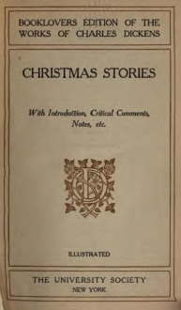
Additions to Authorized Access Points for Works: Conventional Collective Titles
The conventional collective title for collections such as these is “Short stories” (RDA 6.2.2.10.2)
Because none of these collections contains all Dickens’ short stories we add “Selections” (RDA 6.2.2.10.2)
The preferred title is: Short stories. Selections

Slide 85
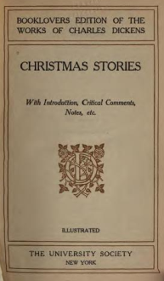
Additions to Authorized Access Points for Works: Conventional Collective Titles
The preferred title is: Short stories. Selections
Remember, these are three separate works.
The access point for each begins
  Dickens, Charles, 1812-1870. Short stories. Selections
RDA 6.27.1.9 says to add something to the access point for a work that is the same or similar to that of another work

Slide 86
Additions to Authorized Access Points for Works: Conventional Collective Titles
We could use form, date, place of origin, or something else to distinguish
Possibilities: Other distinguishing characteristic (title of the collection)
      Dickens, Charles, 1812-1870. Short stories. Selections (Selected short stories)
      Dickens, Charles, 1812-1870. Short stories. Selections (Supernatural short stories of Charles Dickens)
      Dickens, Charles, 1812-1870. Short stories. Selections (Christmas stories)
Notes:
We could distinguish them by the title of the manifestation

Slide 87
Additions to Authorized Access Points for Works: Conventional Collective Titles
We could use form, date, place of origin, or something else to distinguish
Possibilities: Other distinguishing characteristic (compiler of the collection)
      Dickens, Charles, 1812-1870. Short stories. Selections (Thomas)
      Dickens, Charles, 1812-1870. Short stories. Selections (Hayes)
      Dickens, Charles, 1812-1870. Short stories. Selections (University Society)
Notes:
We could distinguish them by the editor (compiler) or publisher (in the last case the publisher is the compiler and we don’t know who the editor is)

Slide 88
Additions to Authorized Access Points for Works: Conventional Collective Titles
We could use form, date, place of origin, or something else to distinguish
Possibilities: Date of the work
      Dickens, Charles, 1812-1870. Short stories. Selections. 1976
      Dickens, Charles, 1812-1870. Short stories. Selections. 2010
      Dickens, Charles, 1812-1870. Short stories. Selections. 1908
Notes:
We could distinguish them by the date of the work. This is possible but doesn’t seem very helpful to the user.

Slide 89
Additions to Authorized Access Points for Works: Conventional Collective Titles
The AACR2 headings for such collections may not be appropriate for use in RDA because they usually represented more than one work
If authorized access points are needed in RDA, they should be established on separate records

Slide 90
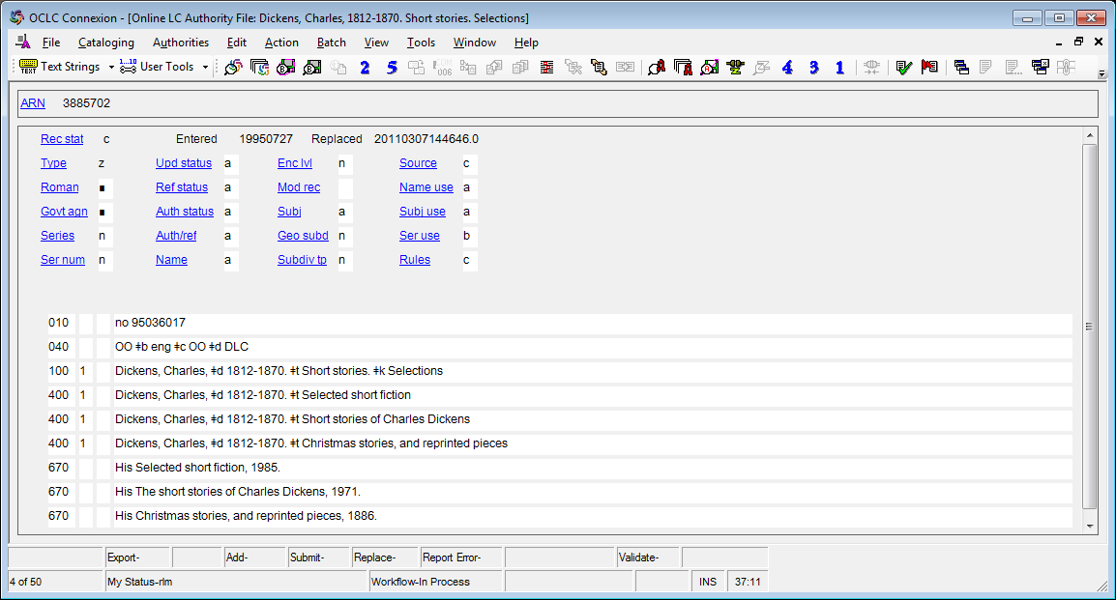
Additions to Authorized Access Points for Works: Conventional Collective Titles
This AACR2 heading cannot be used as an RDA authorized access point because it represents different aggregate works

Slide 91
Additions to Authorized Access Points for Works: Conventional Collective Titles
“Works”
  Conventional collective title for a compilation that purports to be the complete works of a person, family, or corporate body
  Different compilations are treated as different aggregate works
  If a creator’s works have been compiled more than once, the access point usually needs an addition under RDA 6.27.1.9 to distinguish between the aggregate works

Slide 92
Additions to Authorized Access Points for Works: Conventional Collective Titles
“Works”
  The pre-RDA NACO practice was always to add the date of publication to the conventional collective title “Works”
  This is not required under RDA
  Addition only necessary if the preferred title “Works” would conflict (i.e. if the creator’s works have been compiled more than once)
  Addition should be what makes most sense to distinguish, not necessarily the date of publication

Slide 93



Additions to Authorized Access Points for Works: Conventional Collective Titles
Three different aggregate works
Notes:
The great works of Thomas Paine, complete, political and theological (New York : D.M. Bennett, 1878)
The complete works of Thomas Paine (Chicago and New York : Belford, Clarke & Co., 1885). Note, this collection was first published, however, in 1880. The 1885 manifestation is a republication of the same collection, compiled by Calvin Blanchard for Belford, Clarke & Co.
The works of Thomas Paine, secretary for foreign affairs to the Congress of the United States in the late war (Philadelphia: Printed by James Carey, 1797)

Slide 94



Additions to Authorized Access Points for Works: Conventional Collective Titles
All three will have the same preferred title: Works
How can they be differentiated?
  Form of work?
  Date of work?
  Place of origin of work?
  Other characteristic?
Notes:
Discuss here. Form will not work because all three have the same form. Date could be used but would it really help the user find the compilation he/she wants? Place of origin? What is the place of origin? Other characteristic? This could include compiler (either an editor or a publisher that compiled it) or the title of the manifestation, or something else.
The great works of Thomas Paine, complete, political and theological (New York : D.M. Bennett, 1878)
Complete works of Thomas Paine containing all the political and theological writings (Chicago and New York : Belford, Clarke & Co., 1885). Note, this collection was first published, however, in 1880. The 1885 manifestation is a republication of the same collection, compiled by Calvin Blanchard for Belford, Clarke & Co.
Note, this collection was first published, however, in 1880. The 1885 manifestation is a republication of the same collection, compiled by Calvin Blanchard for Belford, Clarke & Co.
The works of Thomas Paine, secretary for foreign affairs to the Congress of the United States in the late war (Philadelphia: Printed by James Carey, 1797)

Slide 95
Additions to Authorized Access Points for Works: Conventional Collective Titles
Possible RDA authorized access points
  Paine, Thomas, 1737-1809. Works (Blanchard)
  Paine, Thomas, 1737-1809. Works (Belford, Clarke & Co.)
  Paine, Thomas, 1737-1809. Works. 1880
  Paine, Thomas, 1737-1809. Works (Complete works of Thomas Paine containing all the political and theological writings)
  Paine, Thomas, 1737-1809. Works (Chicago, Ill.)
Notes:
Note on this and the following slides. Each slides presents several options. Only one can be chosen for each as the authorized access points. Others could be recorded as variant access points if thought useful.
NOTE! This manifestation was published in 1885, but the collection, the aggregate work, was first published in 1880, so the date of the work is 1880.
Could differentiate by name of compiler (either the person or the publisher of the compilation), by date of work, by title of manifestation, by place of publication
Complete works of Thomas Paine containing all the political and theological writings (Chicago and New York : Belford, Clarke & Co., 1885). Note, this collection was first published, however, in 1880. The 1885 manifestation is a republication of the same collection, compiled by Calvin Blanchard for Belford, Clarke & Co.

Slide 96
Additions to Authorized Access Points for Works: Conventional Collective Titles
Possible RDA authorized access points
  Paine, Thomas, 1737-1809. Works (D.M. Bennett)
  Paine, Thomas, 1737-1809. Works. 1878
  Paine, Thomas, 1737-1809. Works (New York, N.Y.)
  Paine, Thomas, 1737-1809. Works (The great works of Thomas Paine, complete)
Notes:
Could differentiate by name of compiler, by name of compiler (here, the publisher), by date of work, by place of publication, by title of the manifestation.
The great works of Thomas Paine, complete, political and theological (New York : D.M. Bennett, 1878)

Slide 97
Additions to Authorized Access Points for Works: Conventional Collective Titles
Possible RDA authorized access points
  Paine, Thomas, 1737-1809. Works (Carey)
  Paine, Thomas, 1737-1809. Works (Philadelphia, Pa.)
  Paine, Thomas, 1737-1809. Works. 1797
  Paine, Thomas, 1737-1809. Works (The works of Thomas Paine, Secretary for Foreign Affairs)
Notes:
Could differentiate this one by name of compiler, by place of publication, by date of the work, by title of manifestation
The works of Thomas Paine, secretary for foreign affairs to the Congress of the United States in the late war (Philadelphia: Printed by James Carey, 1797)

Slide 98
Additions to Authorized Access Points for Works: Conventional Collective Titles
Problem: Because NACO conventions were different previous to RDA, more than one AACR2 heading may be found for the same aggregate work. These should be consolidated for use in RDA.
    Shakespeare, William, 1564-1616. Works. 1974
    Shakespeare, William, 1564-1616. Works. 1997
These were used for two different manifestations of the aggregate work called The Riverside Shakespeare, published in different years. Only one authorized access point is appropriate in RDA.

Slide 99
Additions to Authorized Access Points for Works: Conventional Collective Titles
Possible RDA authorized access points:
  Shakespeare, William, 1564-1616. Works. 1974
    [differentiate by date the aggregate work was first published]
  Shakespeare, William, 1564-1616. Works (The Riverside Shakespeare)
    [differentiate by title by which the aggregate work is known]
  Shakespeare, William, 1564-1616. Works (Evans)
    [differentiate by the chief editor/compiler, G. Blakemore Evans]

Slide 100
Additions to Authorized Access Points for Works: Conventional Collective Titles
Additional problem: Because NACO conventions were different previous to RDA, one AACR2 heading may be found that represents different aggregate works. These should be split for use in RDA.
    Shakespeare, William, 1564-1616. Works. 1997
In addition to The Riverside Shakespeare, this heading was used for at least three other compilations, all published in 1997. These need to be differentiated because they are separate aggregate works.

Slide 101
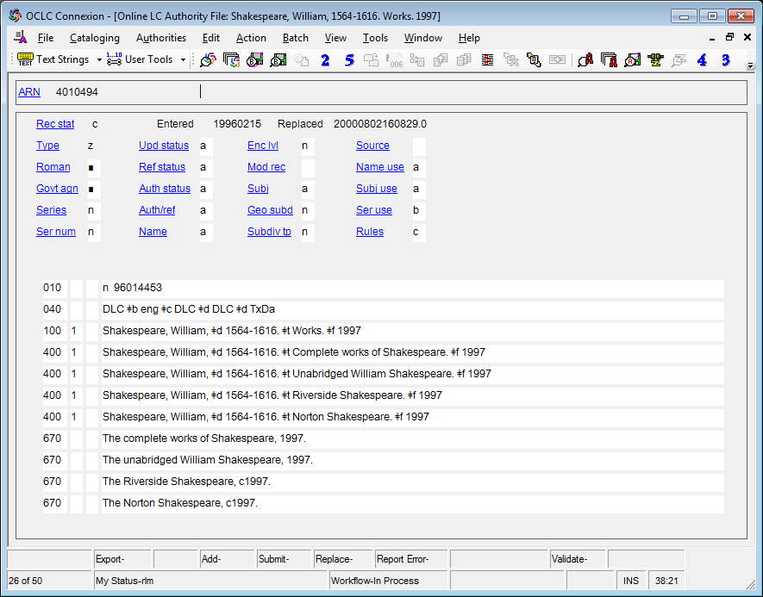
Additions to Authorized Access Points for Works: Conventional Collective Titles

Slide 102

Additions to Authorized Access Points for Works: Conventional Collective Titles
Possible RDA authorized access points for one of these:
  Shakespeare, William, 1564-1616. Works (The Norton Shakespeare)
    [differentiate by title by which the aggregate work is known]
  Shakespeare, William, 1564-1616. Works (Greenblatt)
    [differentiate by the chief editor/compiler, Stephen Greenblatt]
  Shakespeare, William, 1564-1616. Works. 1997
    [differentiate by date the aggregate work was first published—unless this access point has already been used by one of the others. This is probably the least useful since it does not differentiate from others published the same year]
Notes:
The Norton Shakespeare / Stephen Greenblatt, general editor ; Walter Cohen, Jean E. Howard, Katharine Eisaman Maus, [editors] ; with an essay on the Shakespearean stage by Andrew Gurr (New York: W.W. Norton, 1997)
NOTE CAREFULLY: The problem of using AACR2 forms in RDA for authorized access points with conventional collective titles applies to all conventional collective titles and “Selections”, not just “Works”. On the one hand, the AACR2 authority record may represent more than one compilation, and on the other, more than one AACR2 authority record may have been used to represent what is considered in RDA to be the same aggregate work (e.g. because the date of manifestation was added to the heading). In RDA each compilation (aggregate work or part) should be represented by its own record and authorized access point because each is a different work.

Slide 103
Constructing the Authorized Access Point for a Work (MARC)
    100 1 $a Carter, Jimmy, $d 1924- $t Living faith
    100 1 $a Smith, Joseph, $c Jr., $d 1805-1844. $t King Follett discourse
    100 1 $a Mozart, Wolfgang Amadeus, $d 1756-1791. $t Works. $k Selections
    110 2 $a Banco de Bilbao. $t Informe y memoria
    130 0 $a Beowulf
    130 0 $a Primary colors
    130 0 $a Planet of the apes (Motion picture : 1968)
    130 0 $a Encyclopaedia Britannica
    130 0 $a Bible. $p Genesis
    130 0 $a Bible. $p New Testament
    130 0 $a NuTCRACKER (Computer file)

Slide 104
Constructing the Authorized Access Point for a Musical Work
We promised we’d come back to this :-)
Basically constructed like any other work:
  combine the authorized access point for the composer with the preferred title of the work
Except (of course), musical works with preferred titles that are not distinctive (the titles we created by removing parts)

Slide 105
Constructing the Authorized Access Point for a Musical Work
Musical works with preferred titles that are not distinctive (the title is only a type of composition) (6.28.1.9)
Add to the authorized access point as available:
  Medium of performance ($m, preceded by comma)
  Numeric designation ($n, preceded by a comma)
  Key ($r, preceded by a comma)

Slide 106
Constructing the Authorized Access Point for a Musical Work (MARC)
100 1 $a Handel, George Frideric, $d 1685-1759. $t Water music
100 1 $a Bach, P. D. Q., $d 1742-1807. $t Madrigals from The triumphs of Thusnelda. $p My bonnie lass she smelleth
100 1 $a Mozart, Wolfgang Amadeus, $d 1756-1791. $t Concertos, $m piano, orchestra, $n K. 537, $r D major
100 1 $a Michelet, Michel, $d 1894-1995. $t Sonatas, $m balalaika, piano

Slide 107
Constructing Variant Access Points for a Work (RDA 6.27.4)
Variant access points are not core. Include them if in your judgment they would help the user find or identify the work.
  Begin with a variant title (6.2.3)
  Construct the variant access point by combining the authorized access point for the creator with the variant title or by giving the variant title alone
  Make further additions to the access point if you consider them to be important for identification in the same way such additions would have been added to a preferred title. These additions are not required.
Notes:
Read 9.19.2 together.

Slide 108
Related Works (RDA 25)
Related works are recorded in 5XX fields, and may include a relationship indicator in subfield $i (from RDA Appendix J), with $w r.
    100 1 $a Bach, P. D. Q., $d 1742-1807. $t Madrigals from The triumphs of Thusnelda. $p My bonnie lass she smelleth
    500 1 $w r $i Parody of (work): $a Morley, Thomas, $d 1557-1603? $t Balletts. $p My bonny lasse shee smyleth

Slide 109
Exercises
Create on worksheets descriptions of the works Iliad and Piedra de sol
Create authority records for works that workshop participants have brought

Slide 110
RDA authority record core and non-core: work record
040 $a UPB $b eng $e rda $c UPB
046 $k 1957
100 1 $a Paz, Octavio, $d 1914-1998. $t Piedra de sol
370 $g Mexico
380 $a Poem
670 $a Piedra de sol, 1957
Notes:
Note very little is core or required in an RDA record. Institutions may declare other elements to be core. For example, LC has declared that source consulted (670) is core, and undoubtedly PCC will, too, when it settles its core elements. (Language of cataloging is marked in the index as core but not in the rules themselves)

Slide 111
RDA authority record core and non-core: work record
040 $a UPB $b eng $e rda $c UPB
046 $k -07
100 0 $a Homer. $t Iliad
370 $g Ionia $g Turkey
380 $a Poem
400 0 $a Homer. $t Ilias
400 0 $a Homer. $t Ἰλιάς
670 $a The Iliad, 2011: $b title page ([by] Homer)
670 $a Oxford classical dictionary, 1996: $b page 718 (Iliad; attributed in the ancient world to Homer)
670 $a Brill’s new Pauly dictionary of Greek and Latin authors and texts, 2009: $b pages 325-326 (Iliad (English); Ilias (Latin); Ἰλιάς (Greek); by Homer, created second half of 8th century BC in Ionia (Asia minor))
Notes:
Note very little is core or required in an RDA record. Institutions may declare other elements to be core. For example, LC has declared that source consulted (670) is core, and undoubtedly PCC will, too, when it settles its core elements. (Language of cataloging is marked in the index as core but not in the rules themselves)

Slide 112
Module 8
Describing Works
QUESTIONS?
RDA Training
University of Nevada, Las Vegas
May 2013

Slide 113
This Presentation is available at
http://net.lib.byu.edu/~catalog/people/rlm/RDALV201305/index.htm
For further information
contact Robert L. Maxwell
robert_maxwell@byu.edu

